Slide 2
Ascentis Welcomes You
Leading UK Awarding Organisation & Educational Charity
We have 150 delegates in attendance
Insight and expertise into factors that impact our sector and shape the future of education
Workshops and an opportunity to get your burning questions answered by our fantastic speaker panel
Lunch and refreshments will be provided, and the day will conclude with our much-anticipated prize draw, where we will give away a luxury hamper

Slide 3
About Us: The Ascentis Group
Ascentis is both an Awarding Organisation and an Access Validating Agency creating cutting-edge qualifications for FE Colleges, Training Providers, Schools, Employers and many other organisations both in the UK and overseas.
The Ascentis Group includes International Dyslexia Learning (IDL), providing specialist multi-sensory software to primary and secondary schools.
The Ascentis Group also includes Virtual Academy Limited (VAL), an interactive e-learning platform targeted to employers.

Slide 4
Our Qualifications
ESOL – # 1 in UK
Access to HE Diplomas – # 1 in UK
SOQs
Progression & Employability
English & Maths

Slide 5
Spotlight Success: ESOL #1
91,000 Ascentis ESOL Learners
58% of ESOL Learners are based in London
ESOL FAB Award Finalist “Learner of the Year”
The Mayor of London Adult Learning Awards
ESOL Connect –Brand new resources
International ESOL – Italy
(Customised)
Metaverse Learning Partnership

Slide 6
Our Subsidiary: International Dyslexia Learning (IDL)
IDL provides specialist multi-sensory software to primary and secondary schools. Thousands of children across the world use the IDL literacy and numeracy programmes.
Our main goal is to provide learning support to those most in need, and thousands of learners use our software across the globe. IDL was developed to support the growing number of young people who are falling through the gaps in Literacy and Numeracy.
Increase spelling and reading age by 11 months in just 26 hours without needing one-to-one help.

Slide 7
Our Subsidiary: International Dyslexia Learning (IDL)

Slide 8
Our Subsidiary: Virtual Academy Limited (VAL)
VAL works with industry experts to deliver interactive learning modules on an e-learning platform
VAL provides and improves:
- Workforce Engagement
- People Development
- Skills and Capability
- Online Training

Slide 9
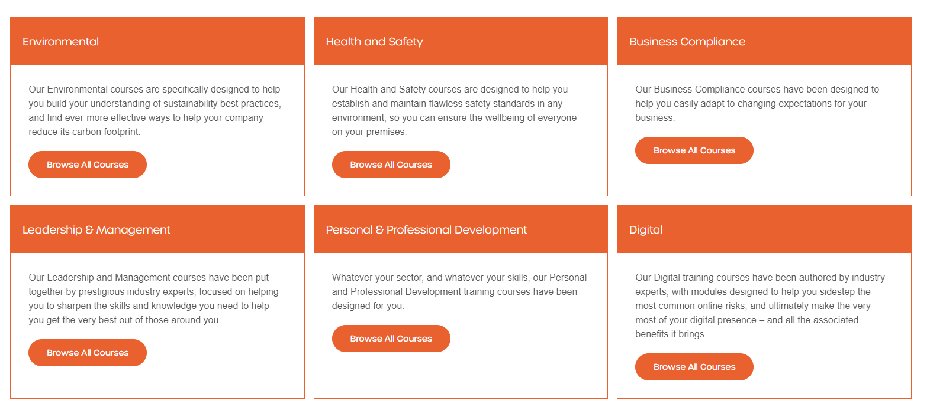
Our Subsidiary: Virtual Academy Limited (VAL)

Slide 10
The Landscape
The landscape of education is undergoing profound changes, propelled by technological advancements, societal shifts, and the dynamic needs of our learners.
We must adapt and evolve to ensure our education system remains a symbol of hope and opportunity for all.
We must cater to our learners' diverse learning styles and preferences, cultivating an environment that nurtures curiosity and stimulates creativity.
We must strive to create an educational ecosystem that is accessible to everyone, irrespective of socio-economic background, ethnicity, or physical abilities.
In the pursuit of excellence, we must also prioritise the well-being of our educators – YOU!
Notes:
You are the architects of our educational landscape, shaping the minds and aspirations of the next generation. Investing in professional development, mental health support, and creating a nurturing work environment are crucial steps in ensuring that our educators can continue to inspire and lead with passion.

Slide 11
Our Thanks
For all our current centres in attendance today who have chosen us as their Awarding Organisation
For any potential future centres in attendance today who might consider partnering with us
And to all those who have dedicated their time to join us, we extend our gratitude
Feel free to approach any Ascentis staff member identifiable by their green lanyards—they are ready to assist you

